Slide 1
Data & Analytics - Iris Flower
Yang Leyuan
National University of Singapore
Business Analytics & Statistics

Slide 2
TABLE OF CONTENTS
01
02
03
Problem & Dataset
Visualization
Data Modelling
-Motivation
-Data Quality
-Data Transformation
-Logistics Regression
-KNN Classifier
-Support Vector Classifier
-Classification & Similarity
-Limitation

Slide 3
Motivation
-Analyse collected data
Features
Correlations
Outliers
-Model selection & Training (Multiclass model)
Logistics Regression
K-nearest neighbours Classifier
Support Vector Classifier
-Prediction
Retrieve records of the most similar Iris flowers in his garden for any input Iris flower based on historical data
?
Classify the input data belongs to which class then find nearest neighbors

Slide 4
Data Quality
01

Slide 5
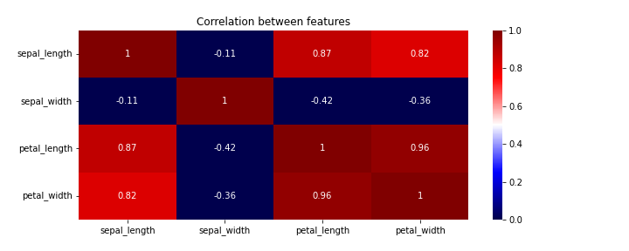
Correlation
Petal length is highly correlated with petal width & sepal length

Slide 6
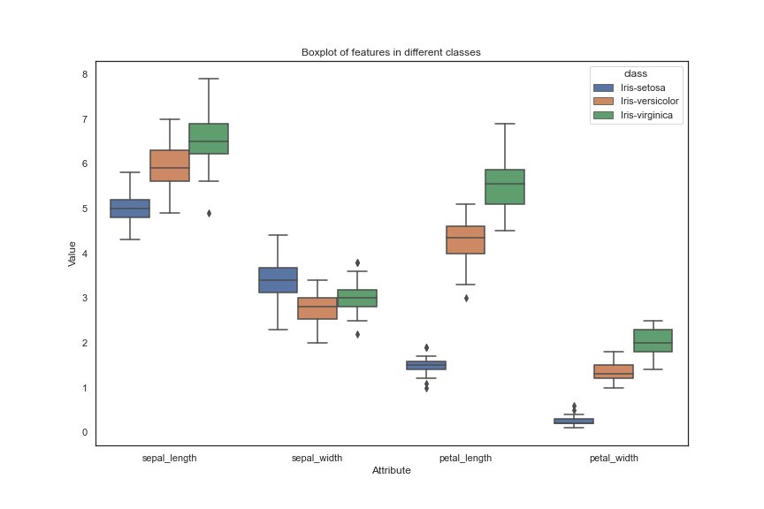
Correlation
Abnormal sepal width data of Setosa class

Slide 7
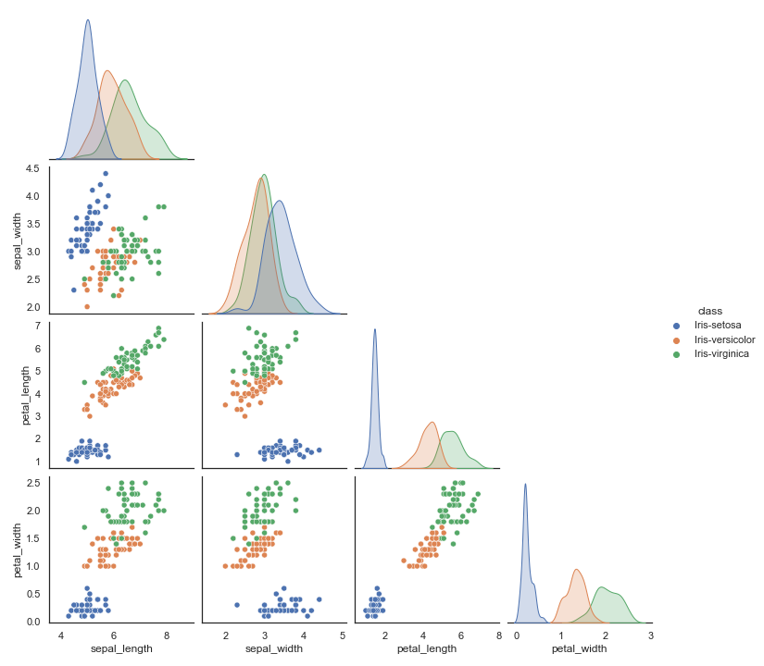

Slide 8
Conclusion of data quality
-Sample size too small
-Features are highly correlated
-Abnormality of records

Slide 9
Data Modelling

Slide 10

Split data
Training data
Testing data
70%
20%?
Accuracy is 1.0
30%

Slide 11
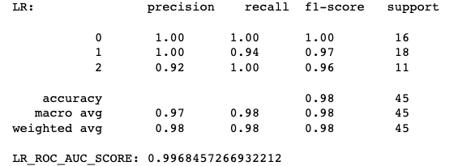
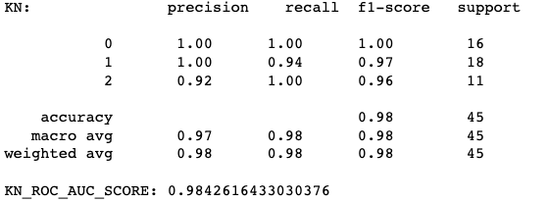

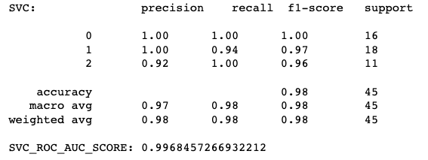
Logistics Regression
KNN
SVC

Slide 12
Data Visualization

Slide 13
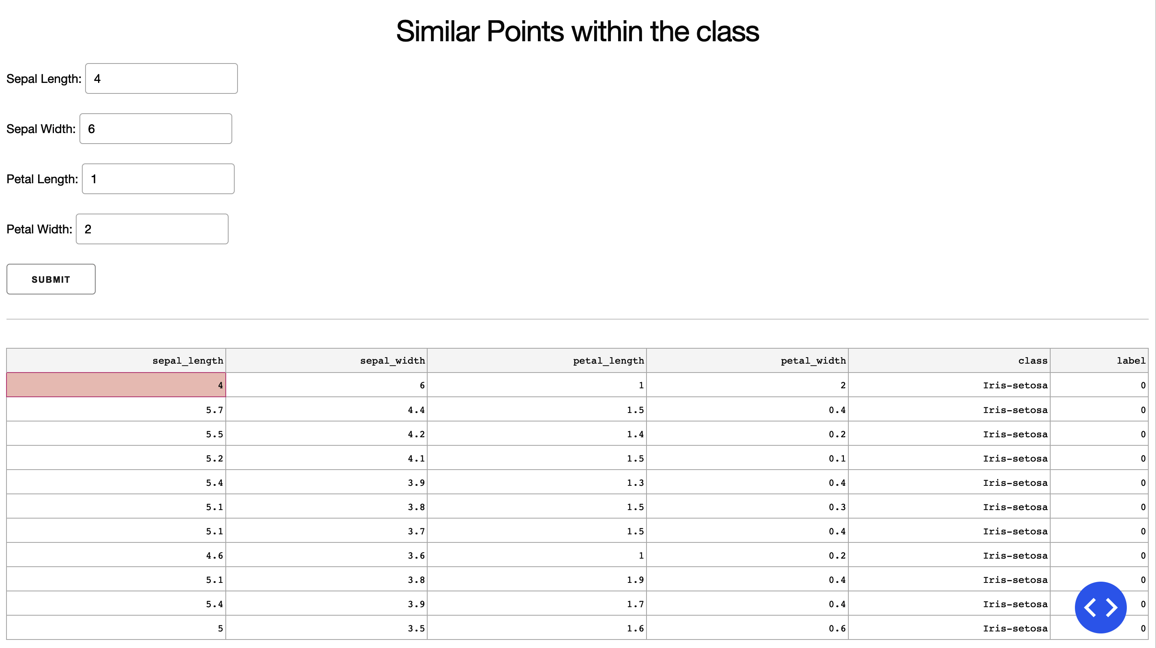

Slide 14
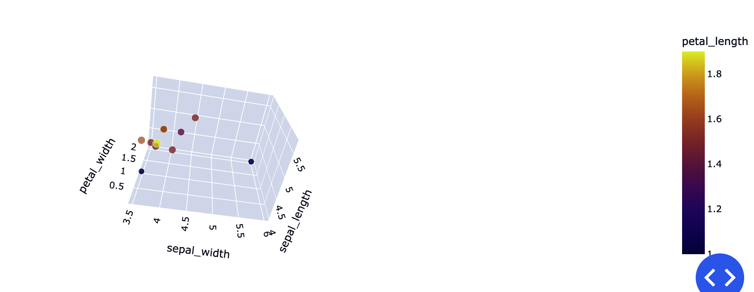

Slide 15
Limitations
Over/Underfitting
Other ML models
Interface
Accuracy
Cross validation
DecisionTree Classifier
XGBoost
Random Forest
……
UI design
Various plots
Split Petal & Sepal into two datasets and build models for each

Slide 16
Questions? Thank you!

